Slide 1
Introduction to Networks and Networking Concepts
Chapter 1

Slide 2
Learning Objectives
Understand basic networked communications and services
Identify essential network components
Describe the benefits of networking
Understand and compare peer-to-peer and server-based networks
Apply your knowledge when selecting an appropriate network type for small business use
Suggest possible redesigns for a small but expanding network

Slide 3
What is Networking?
Connecting computers to share information and resources
Many choices for physical connections and related software
Important in the workplace

Slide 4
Networking Fundamentals
As simple as two computers connected with a cable that can transmit data
Need to share data quickly and efficiently
Access peripheral devices such as printers, scanners, and fax machines

Slide 5
Advantages of Networks
Allow groups of users to exchange information and share data
Allow easy and efficient communication among individuals, including electronic mail (e-mail)
Allow users to share peripherals such as printers, scanners, fax machines, and other devices

Slide 6
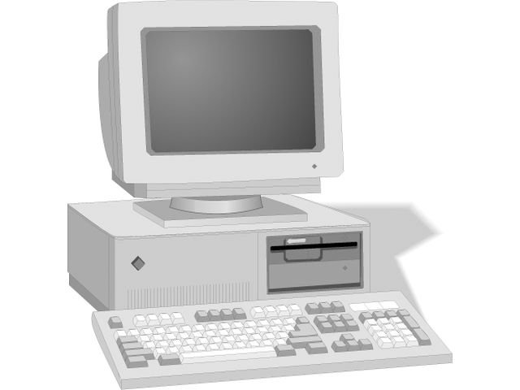
Standalone Computer and a “Sneakernet”
Standalone computer
Single computer not attached to a network
Cannot match power and convenience of network
“Sneakernet”
Passing floppy disk from machine to machine
Old alternative to networking

Slide 7
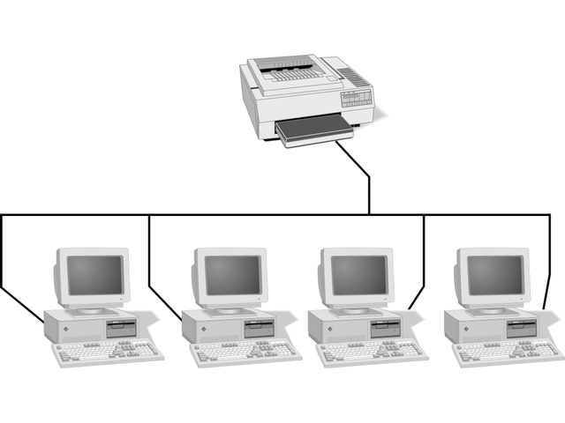
Sharing Resources on a Simple Network
Networking computers allows them to:
Share data
Access shared printer and other equipment

Slide 8
Local Area Networks (LANs) and Internetworks
Early networks – custom-built, expensive, severe restrictions
Early Ethernet – no more than 30 users with total span of 607 feet
Local area network (LAN) – works within limited geographic area
Building block for constructing larger networks, called internetworks
Internetwork – network 100 or more computers at distances in excess of 1000 feet

Slide 9
Wide Area Networks (WANs) and the Internet
Wide area network (WAN) – spans distances measured in miles; links two or more separate LANS
Metropolitan area network (MAN) – uses WAN technology to interconnect LANs within a specific geographic region
Internet – global WAN internetwork; includes millions of machines and users worldwide

Slide 10
A Networking Lexicon
Must understand specialized networking vocabulary, including
Server — shares resources across network, typically with more central processing unit (CPU) power and storage capacity than other computers
Client — accesses shared resources
Request-response — client requests information; server responds by providing information
Client-server relationship — see Figure 1-3
Peer-to-peer — computers share and request resources from one another

Slide 11
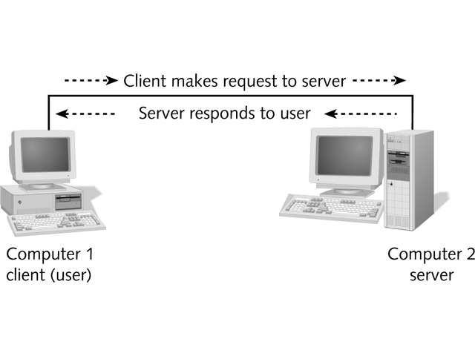
Client-Server Relationship

Slide 12
Network Medium Carries Network Messages
Computers share access to common network medium that carries signals from one computer to another
Medium may be physical cable, such as twisted pair, coaxial, or fiber-optic
Medium may be wireless
Physical interface to medium is usually network interface card (NIC) or network adapter
Kind of medium dictates type of connector and limits number and type of devices as well as distance a single LAN can span

Slide 13
Network Protocols
Network protocols – a common set of rules
Define how to interpret signals, identify individual computers, initiate and end networked communication, and manage information exchange across network medium
Include TCP/IP, NetBEUI, IPX/SPX, and NWLink

Slide 14
Network Software
Network software issues requests and responses
Network operating system (NOS) controls which computers and users access network resources
Include both client and server components
Popular NOSs include Windows .NET Server, Windows XP, Windows 2000, Windows NT, and Novell NetWare
Network applications access the network
Include e-mail programs, web browsers, and network-oriented utilities

Slide 15
Network Services
Services include file and print services, file-sharing, e-mail, and other capabilities
Network communications are layered
Network applications use NOS or client networking software to get network protocol to access medium
Medium exchanges information with other computers
Figure 1-4 shows layers of networking process
Each higher layer depending on one beneath it

Slide 16
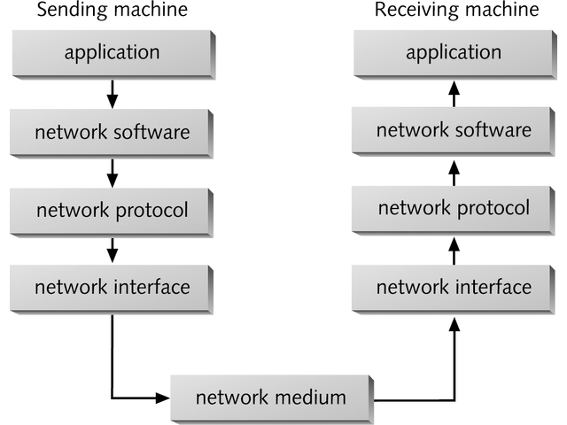
Layers of the Networking Process

Slide 17
Network Types
Two major types of networks
Peer-to-peer
Client/Server (also called server-based)

Slide 18
Peer-to-Peer Networking
Peers with no centralized control over shared resources
Can share resources with any other computer on network
No computer has higher access priority
No computer has more responsibility to provide or shared resources
Figure 1-5 shows typical peer-to-peer network

Slide 19
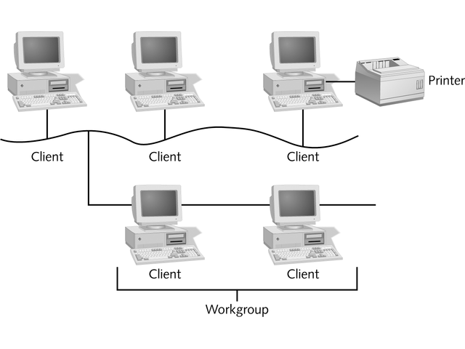
Peer-to-Peer Network

Slide 20
Peer-to-Peer Networking Advantages
Easy to install and configure
No dedicated server
Users control own shared resources
Inexpensive to purchase and operate
No additional equipment or software
No dedicated administrators
Works best with 10 or fewer users

Slide 21
Peer-to-Peer Networking Disadvantages
Security applies to single resource at a time
Users may have many different passwords
Must back up each machine individually
Machine sharing resources may suffers reduced performance
No centralized organization scheme to locate or control access to data
Does not usually work well with more than 10 users

Slide 22
Server-Based Networks
Server responds to client requests
Figure 1-6 shows a typical server-based network
Provide centralized control over resources
Servers require faster CPUs, more memory, larger disk drives, and extra peripherals such as tape drives
May be dedicated, handling only requests from client communities

Slide 23
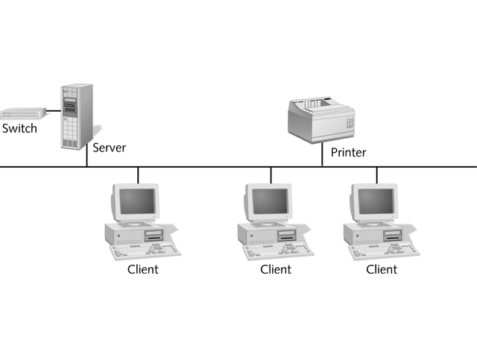
Server-Based Network

Slide 24
Server-Based Networks
One or more servers may do centralized verification of user accounts and passwords
Windows NT and Windows 2000 use a domain model
Checks account names and passwords against database
Windows 2000 calls it Active Directory
Novell NetWare calls it Novell Directory Services (NDS)
Easier to scale
May handle thousands of users

Slide 25
Server-Based Networking Advantages
Simplifies network administration
Centralizes user accounts, security, and access controls
More powerful equipment
More efficient access to network resources
Single password for network logon
Best choice for networks with 10 or more users or network with heavily-used resources

Slide 26
Server-Based Networking Disadvantages
At worst, server failure renders network unusable
At least, server failure causes loss of network resources
More expensive
Requires expert staff to handle complex server software
Requires dedicated hardware and specialized software

Slide 27
Storage-Area Networks (SANs)
New type of network
Uses high-speed network links between servers in enterprise and centralized storage systems
Data and applications reside on centralized storage
Sideband link connecting SAN components is completely separate from network that links clients and servers
Figure 1-7 shows typical storage area network

Slide 28
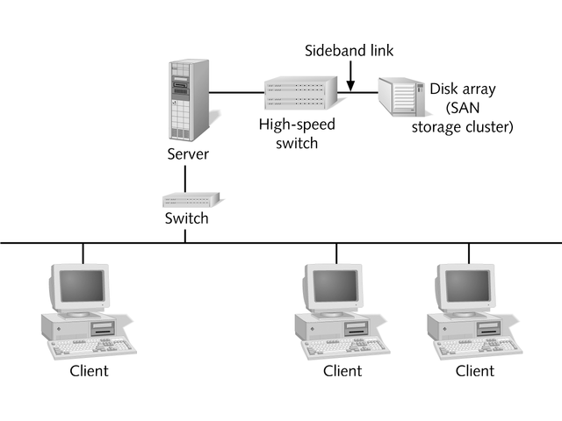
Storage-Area Network (SAN)

Slide 29
Storage-Area Networks
Provide centralized control over network storage
Much more expensive than conventional storage
Offer many advantages, including
Fast access to SAN storage
Backups from single location
Fastest, more reliable storage subsystems, including hot-swappable power supplies and disk drives
Extra level of security and access control
Easier to increase storage capacity

Slide 30
Personal Area Networks (PANs)
Short-range networking technology that uses the body for transmitting signals
Include devices that user wears or comes in close contact with
Cell phones, pagers, personal digital assistants (PDAs), and even watches
Transmit for short range, typically 10 meters or less
Use secure access method

Slide 31
Personal Area Networks (PANs)
No single standard exists for PANs
Apple developed short-range networking technology called Bluetooth
IEEE is creating a standard named P802.15, dubbed wireless personal area network (WPAN)

Slide 32
Hybrid Networks
Combination networks
Workstations function simultaneously as peers on a peer-to-peer network and as clients on server-based networks
Modern operating systems can function both as peers and as clients
Windows NT, Windows XP, Windows .NET Server, and Windows 2000

Slide 33
Server Hardware Requirements
Equip server with fastest CPU, as much RAM as possible, as much disk space as it will hold, and fastest NIC available
Windows 2000 Server and Windows .NET Server handle up to 32 CPUs in single system
Specialized versions handle 64 or more processors
Table 1-1 shows minimum and recommended hardware requirements for Windows 98, Windows .NET Server, and Windows 2000 Server
Industry consensus on recommended values appear in parentheses

Slide 34
Application Servers
Supply server side of client/server applications
Provide processing service and handle requests for file or print services
Example: database server supplies query-processing and data-analysis facilities; repository for huge amounts of data within database

Slide 35
Communication Servers
Allow users outside network to access network’s resources (inbound communications)
Sometimes permit users on network to access resources outside network (outbound communications)
Users may dial into network with modem
Example: Windows 2000 Server includes Remote Routing and Access Server (RRAS)

Slide 36
Domain Controllers/ Directory Servers
Let users locate, store, and secure information about network and its resources
Windows NT Server combines computers, users, groups, and resources into logical domains
Domain controller or directory server handles logon service
By logging onto domain, user has access to all permitted resources and information
Windows 2000 Server and NetWare 4.x and newer versions include software to let server function as domain controller or directory server

Slide 37
Fax Servers
Manage fax traffic on network
Receive incoming faxes via telephone
Distribute faxes to recipients
Collect outgoing faxes to send via telephone
Must have at least one fax modem interface
Third-party vendors supply software to create Windows, NetWare, or Linux-based fax servers

Slide 38
File and Print Servers
Provide basic network file storage and retrieval
Provide access to networked printers
Users run applications locally but keep data files on server and print hard-copies
Any Windows, NetWare, or Linux server can act as file and print server

Slide 39
Mail Servers
Handle e-mail messages
Provide “store and forward” services
Hold incoming e-mail messages until users access them
Can hold outgoing e-mail messages until forwarded to their destinations
Microsoft Exchange Server runs on Windows NT and Windows 2000; NetWare and Linux use other e-mail server programs

Slide 40
Web Servers
Has gained popularity faster than any other single service
Many companies use WWW and TCP/IP protocol to distribute information via the Internet
May set up Web server to handle Internet traffic
Windows .NET Server and Windows 2000 Server include Internet Information Server (IIS), a complete Web server
NetWare versions 4.x and 5.x include Netscape Web server
Apache Web server is available free for Linux

Slide 41
Web-Based Networks
Internet and the WWW are becoming part of our everyday lives
Most computers are connected to Internet
Handheld devices such as cell phones and PDAs are connected through wireless communications
Cable modems and high-speed connections are common at work and home
New technologies such as Microsoft .NET will further integrate Web into our lives so that the Web is the network

Slide 42
.NET Computing
Uses Web to deliver information, applications, allow devices to communicate and share data
Permits handheld computers to transfer information to and from network server using the Web
Allows transfer of information with unprecedented ease and convenience

Slide 43
Web-Enabled Devices
PAN includes many Web-enabled devices that can transmit information via the Internet
Other devices are becoming Web-enabled such as automobiles with wireless navigation systems
Networking paradigm is shifting from clients and servers to Web-enabled or not Web-enabled
Client will be any Web-enabled device that needs information
Server will be any Web-enabled device that provides information

Slide 44
Selecting the Right Type of Network
Choose peer-to-peer networking only if all these conditions are true:
Network includes no more than 10 users
All networked machines are close enough form single LAN
Budget considerations are paramount
No specialized servers are needed

Slide 45
Selecting the Right Type of Network
Choose server-based network when one or more of the following conditions is true:
More than 10 users share network access
Centralized control, security, resource management, or backup is desirable
Need specialized servers
Heavy demands for network resources
Use Internetwork or require WAN access
Consider future growth
Even if peer-to-peer network serves current needs, may be best to implement server-based network

Slide 46
Chapter Summary
Basic elements of networks include networking medium (cabling) and computers with physical interface (network adapter) to medium
Computers must also have network protocol and network software to send and receive messages across network
Network services include file sharing, printing, e-mail, and other messaging services

Slide 47
Chapter Summary
Four basic types of networks include peer-to-peer, server-based, storage-area, and hybrid
Personal area network (PAN) is new kind of network limited to small area around a person
Major criteria for selecting network type include budget, number of users, types of applications or network services, and requirements for centralized administration and control

Slide 48
Chapter Summary
Servers require specialized hardware and software
Servers may take specific roles, serving as file and print servers, fax servers, e-mail servers, application servers, and so on

